Slide 1

Loan Predictions
Mini-Project IV - Lighthouse Labs

Slide 2
Agenda
EDA
Machine Learning Pipeline
Results
Challenges and Next Steps
Notes:
First I’ll be discuusing data analysis
Walk you through my machine learning pipeline
Discuss the results
And finish off with any additional challenges I had

Slide 3
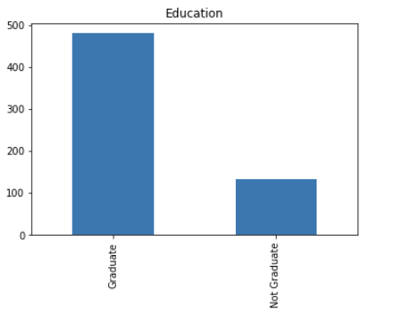
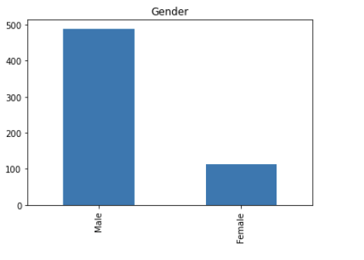
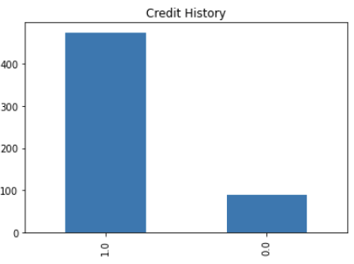
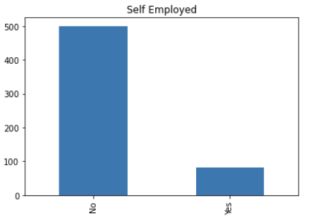
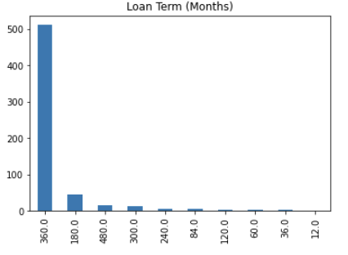
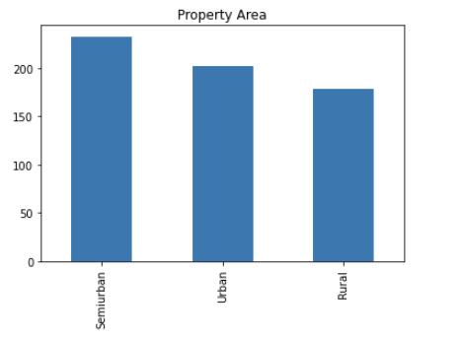
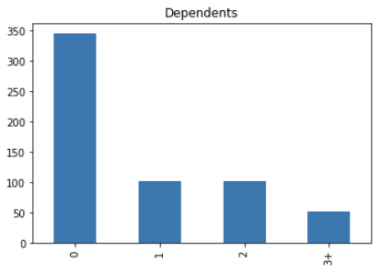
Categorical Features
Notes:
I know you can’t see this very well, but the point I wasnt to get across is that the categorical data set, with the exception of property area wasn’t balanced - had null values, but wasn;t a huge data set so instead of removing them - in the case of these, I replaced them with the most frequent category
I got super bogged down in the analysis trying to figure out how or if nulls should be filled in, and extra fields.. Then I went for a run and RemeberedI have a machine that can help me decide … ran base model, with grid search of the different factors - how remove outliers removed outliers, filling null values, column feature preprocessing
*show some interesting plots - how ending formatting
* limitation is data set size - too many features to data set size - rfe
*PCA and k

Slide 4
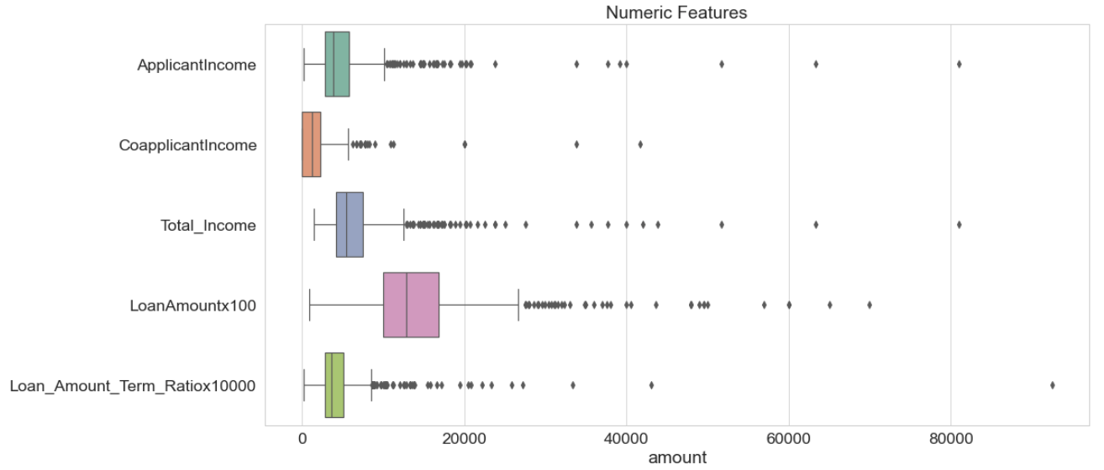
Numeric Features
Notes:
Had a lot of outliers , and was left skewed.
Changed the scale here this box plot to see it a bit better - also combined
Would have liked to have done the log transform first than remove outliers, but the way the pipeline worked (if I removed I’d have to remove corresponding y), I removed outliers first then log transform

Slide 5
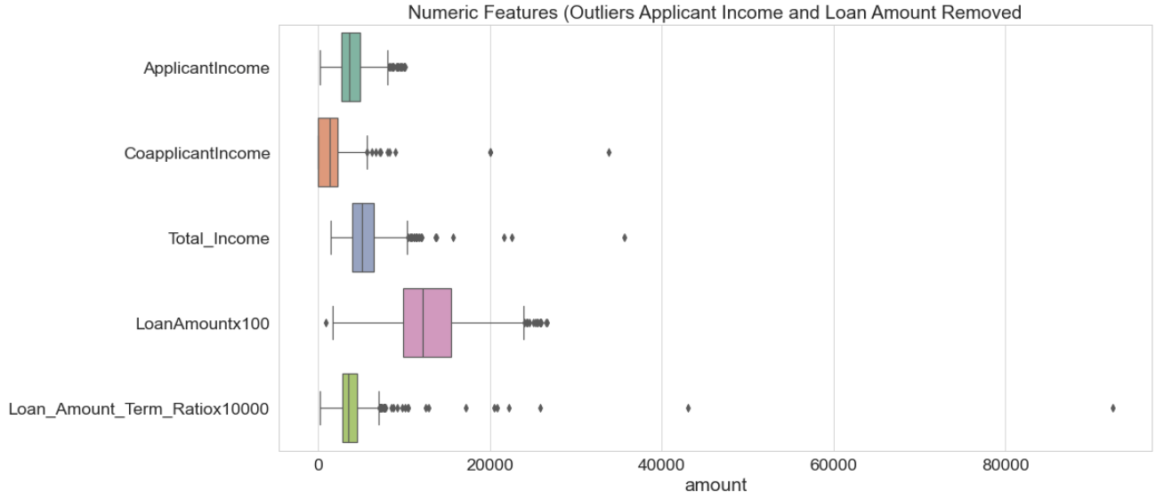
Outliers (Applicant Income and Loan Amount Removed)
Notes:
Removed the top end otliers
The ratio is calculated within an in pipeline calculated value - if I had more time, I’d go back and add a condition to the outliers remover function to include that datapoint - still skewed -log

Slide 6
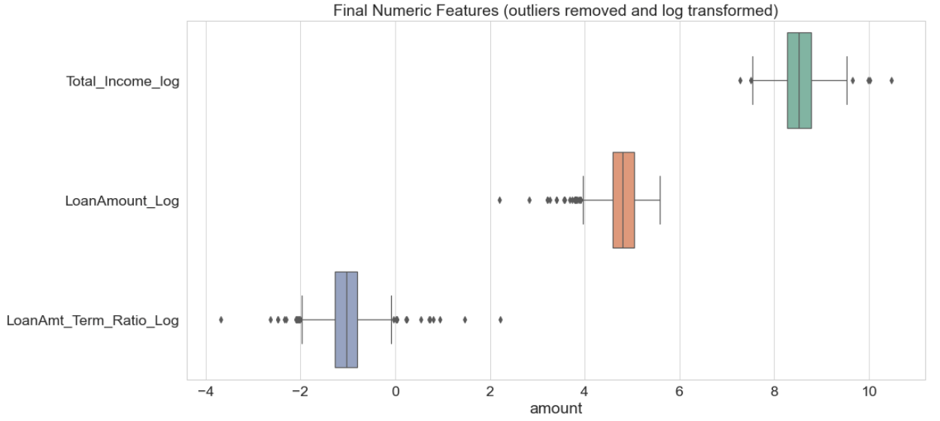
Outliers Removed and Log Transformed

Slide 7
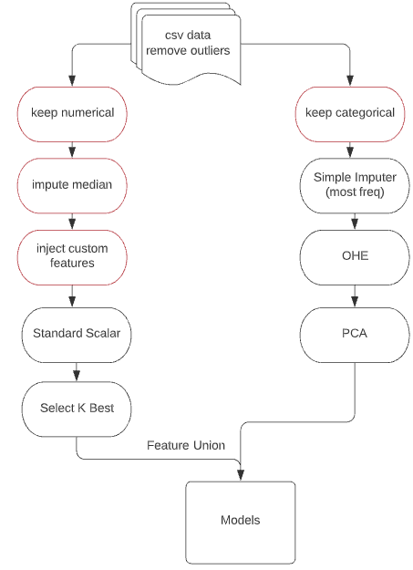
Pipeline diagram
Notes:
Removed any rows with more than one nul vale (13)
Removed outliers on 2 columns
Grid search pca and kbest hyperperameters in case of random forest -
Did this for 3 different models - Naive bayes,
Data we were given was mostly categorical
Quite small (just over 600 data points, but quite a bit of missing values)
And as skewed, or unbalanced which made it easy to
Didn’t want to remove too many - did remove any rows that have more than one missing value ()13)

Slide 8
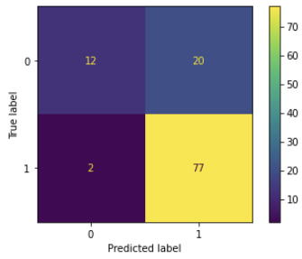
Results
Random Forest with grid search (scoring f1) on
PCA components - categorical (9)
K best numeric (included loan term in this and scaled) (1)
N_estimators (100)
max_depth (2)
Metrics for best model
F1: 0.88
Accuracy: 0.80
Recall: 0.67
Precision 0.81
Notes:
F1 balance between accuracy and recall
20, 80 split so here is the confusion matrix

Slide 9
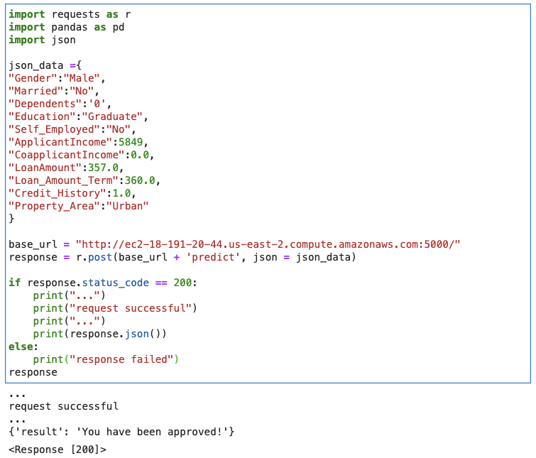
http://ec2-18-191-20-44.us-east-2.compute.amazonaws.com:5000/predict
Notes:
This the best model was save to pickle file and copied to the aws platform with with rest api app file
Which is running on tmux and can access predictions with post request. I tested /predict endpoint out with my jupyter notebook.
Initial plan was deploy the model with docker to aws, but ran out of time with all the challenges
Include url link
REST api is Running with tmux, and results can be retrieved using post request

Slide 10
Challenges - and if had more time
Better tune, and add more hyperparameters
Try additional models (SVM)
Improve plotting (Pandas pivot)
Function Transformer required column names AND nulls removed
Docker container for deploy
Notes:
What didn’t go wrong = it was a comedy of errors - one giant debugging session - this one was a doozy
Log transform of
If used simple imputer, it would become a numpy array and column names were removed
Next time use only some of the column transformer separately?

